Slide 1

Spatial Analysis using Text as Data
MUSA 508
Week 12

Slide 2
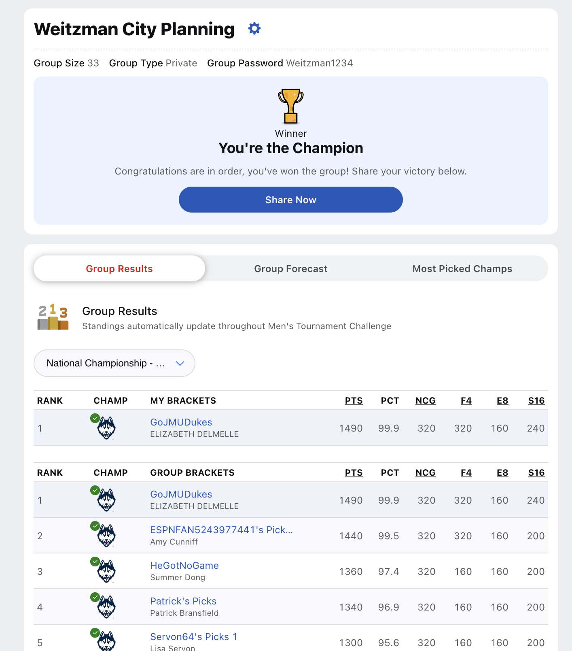
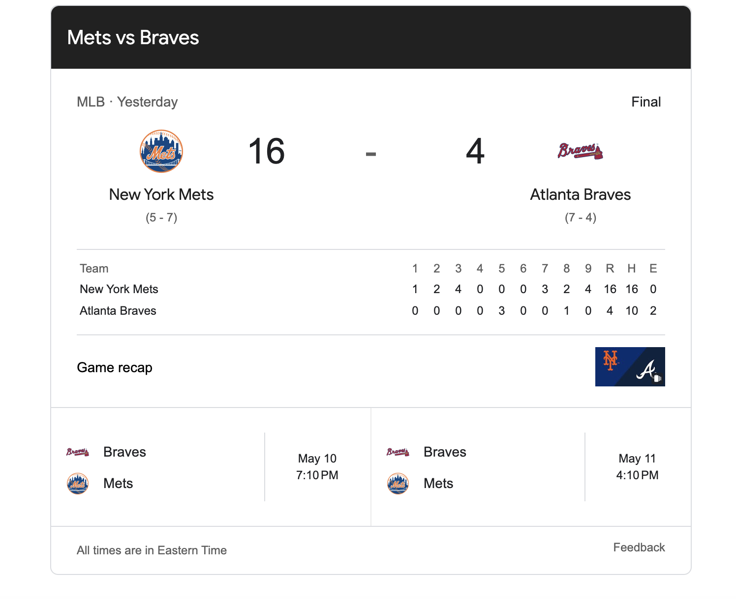

Slide 3

The Agenda
A Motivating Case Study!
The Recipe for Replicating
Clustering (K-means)
Working with Text
Simplifying & Quantifying
Summarizing
Modeling

Slide 4
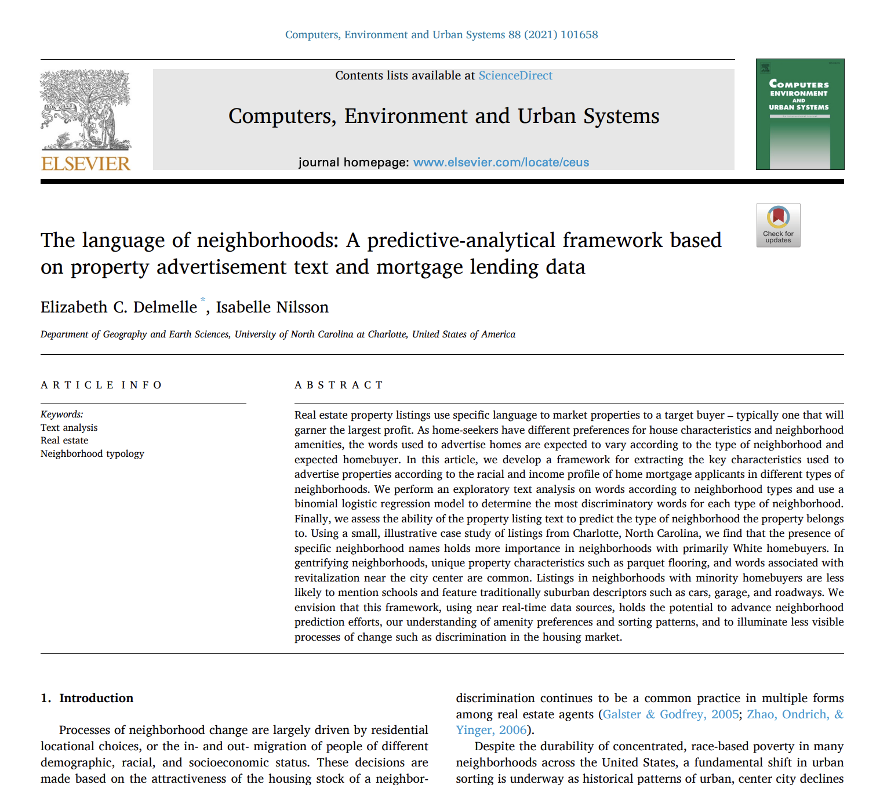
The Motivating Example: Using Real Estate Listings to Study Neighborhoods

Slide 5
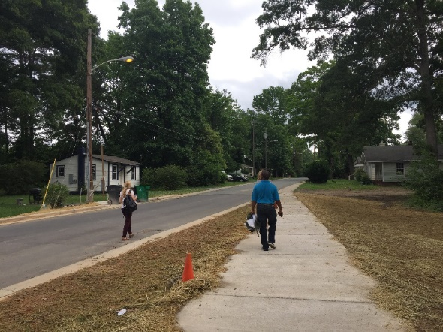
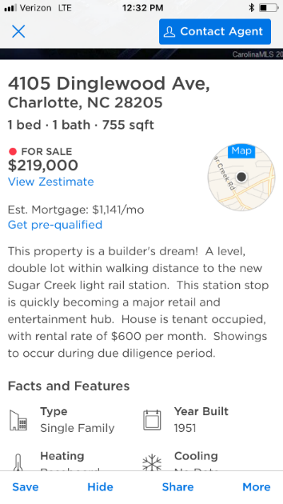

How it all began..
What can property text advertisements tell us about:
What invisible changes are taking place in the neighborhood?
Relative importance of various amenities in residential sorting?

Slide 6
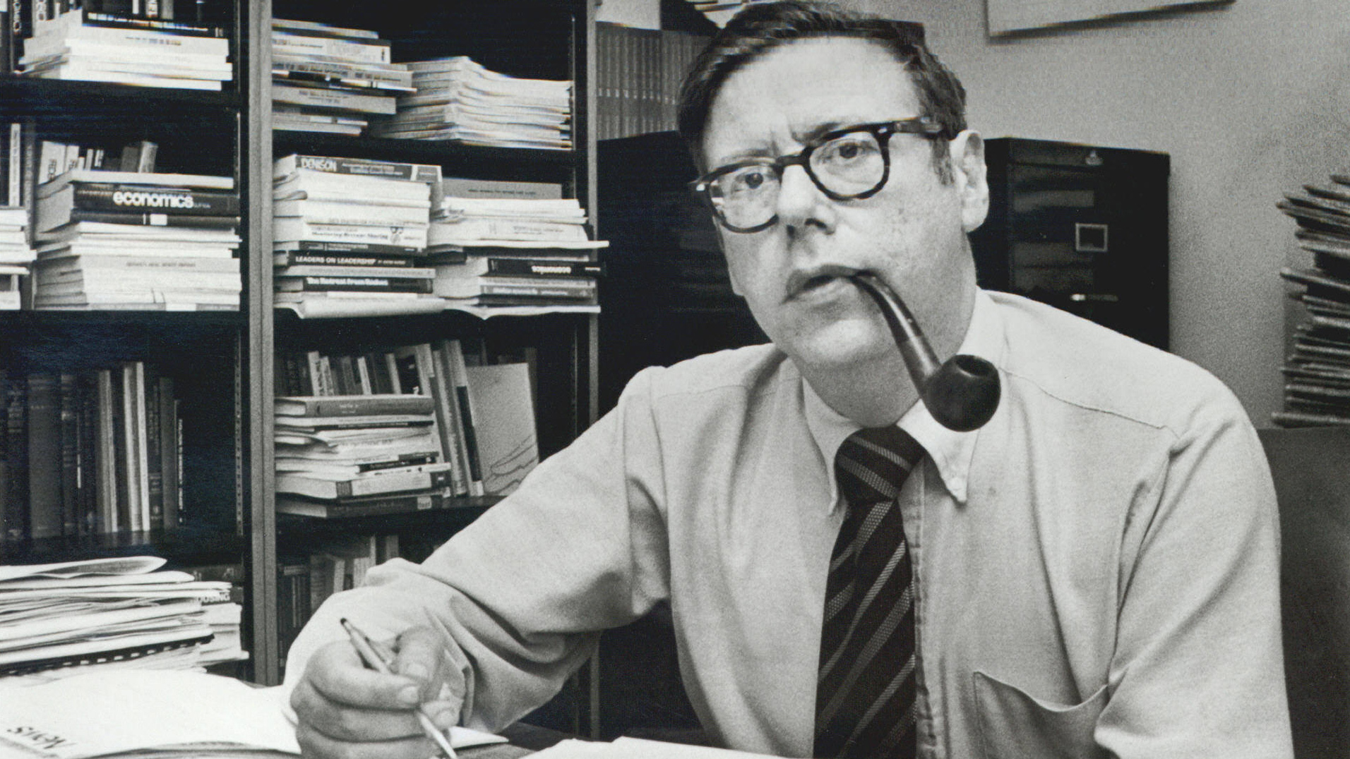
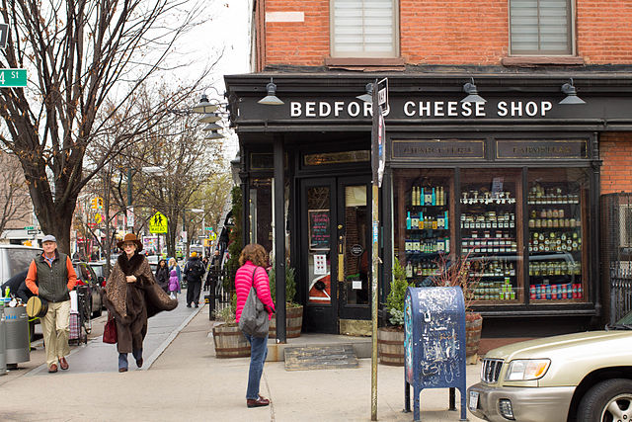
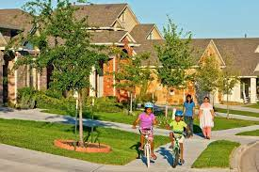
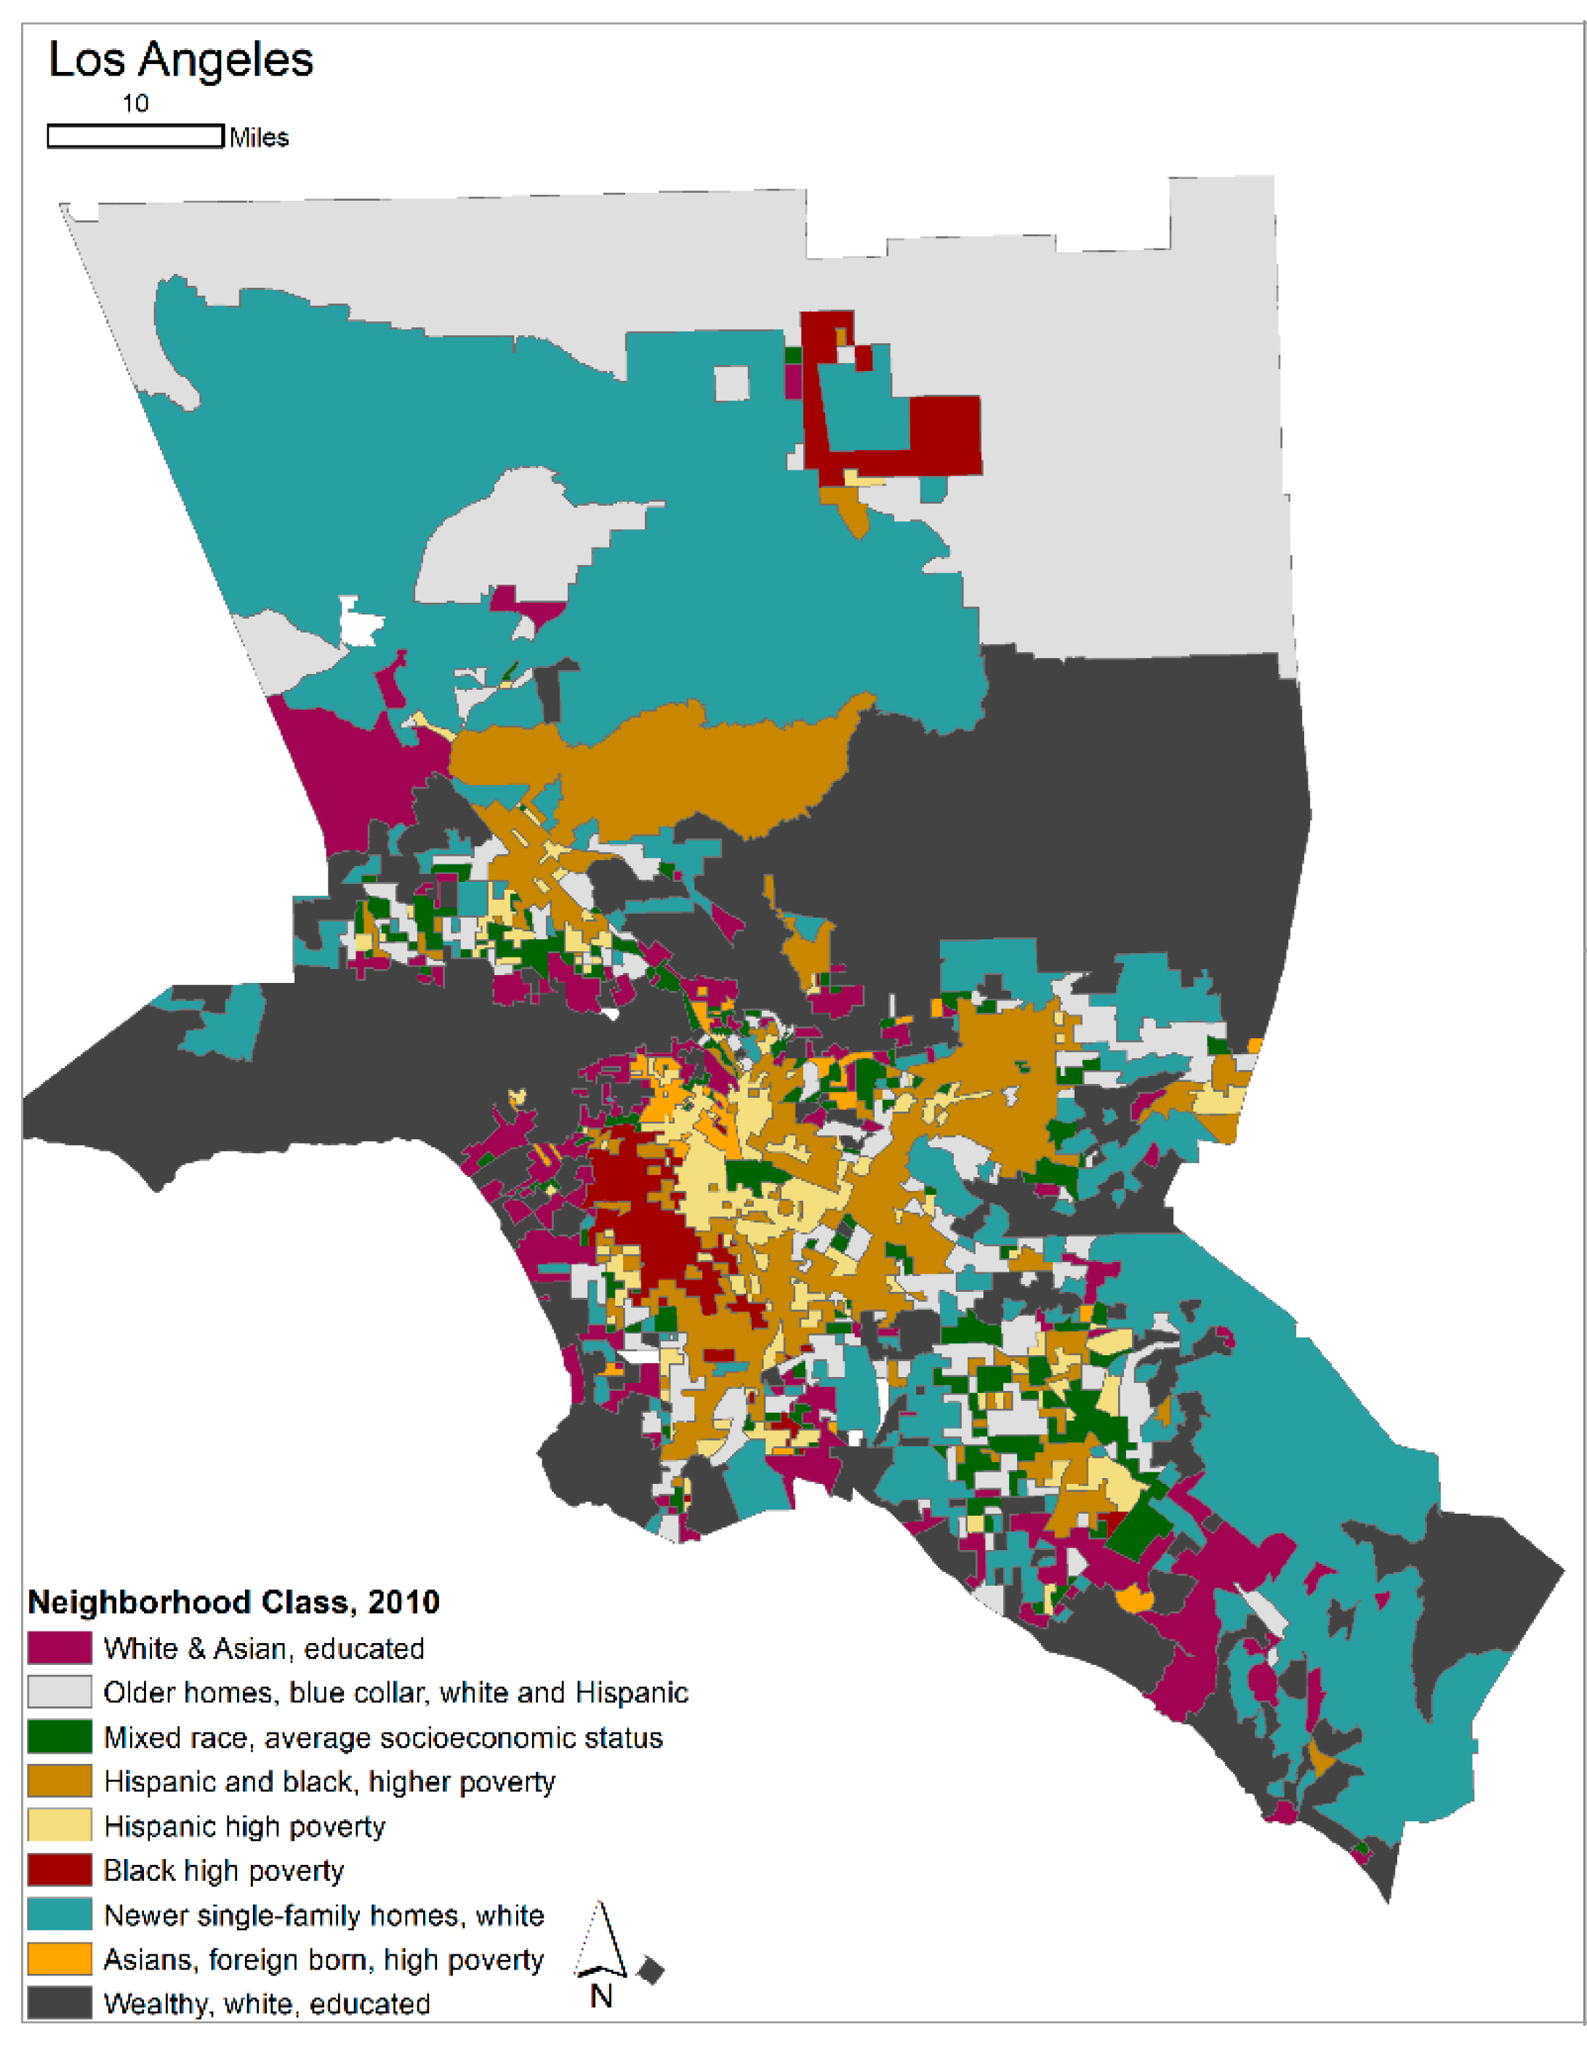
Background
Neighborhood changes are ultimately the result of the in and out migration of residents.
Amenity-based framework for understanding residential sorting.

Slide 7
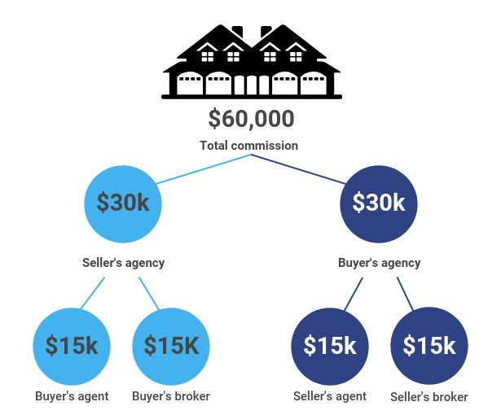
However…
The housing market is far from an equal opportunity one.
Years of discriminatory processes have prevented groups of individuals from realizing the homes & neighborhoods of their choosing.
What role to listings play in sorting process?
Does the language used vary by the racial makeup of neighborhoods and
who is purchasing homes in those neighborhoods?

Slide 8
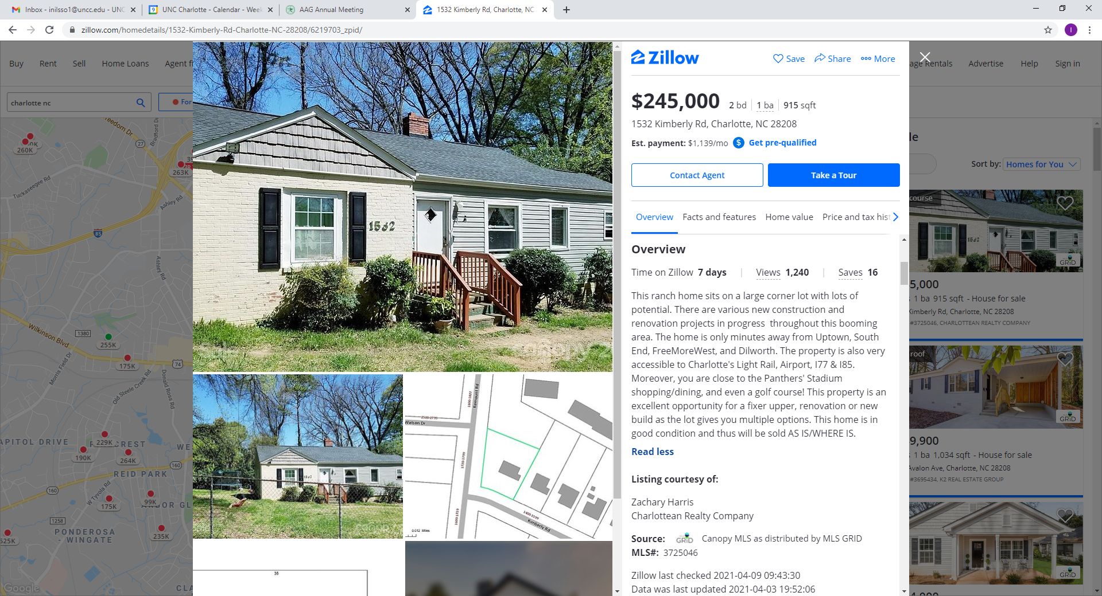
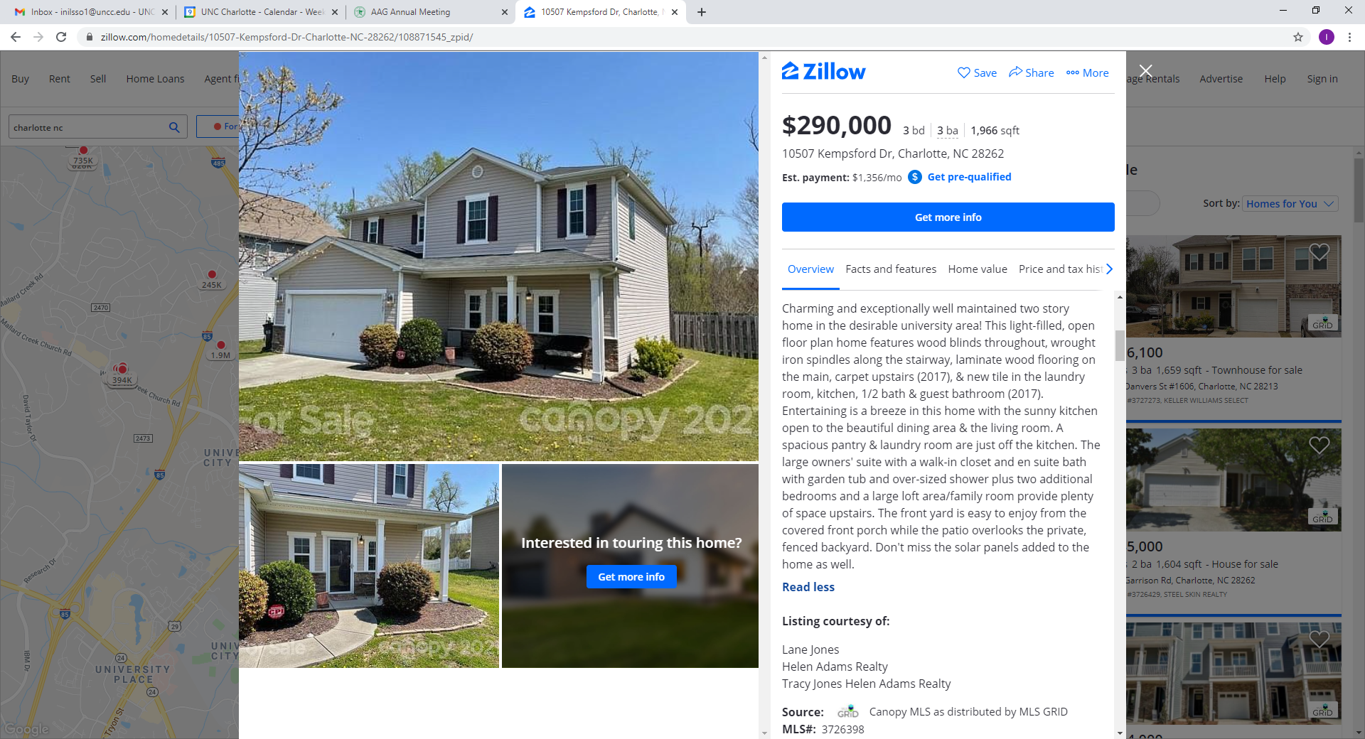
Objective 1
Blend property descriptions (public remarks) with annually updated Home Mortgage Disclosure Act (HMDA) data to:
Develop framework to understand relative importance of amenities in residential sorting patterns
Predict neighborhood type based on text (and going forward: neighborhood change)
Potential to understand changes in real time than retrospective surveys on aggregate neighborhood statistics

Slide 9
Methodological overview
Develop Neighborhood Typologies Using HMDA Data
Who is moving into what kinds of neighborhoods
Exploratory Text Analysis
Frequency of words by neighborhood type
Logistic Regression Model
- Relative importance of words
- Predict neighborhood type property is located in using property descriptions
Notes:
Here I will present out proof-of-concept/pilot study we performed on Charlotte, NC

Slide 10
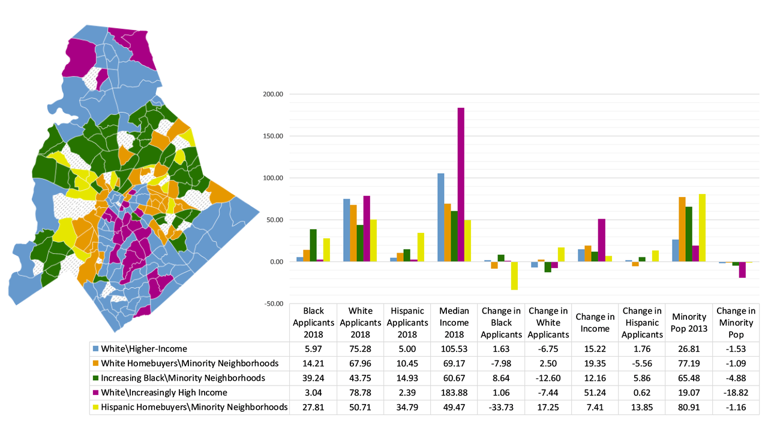
Neighborhood Typology
Neighborhood Typology (Using k-means & HMDA data)
Notes:
We begin by classifying neighborhoods (Census Tracts) according to the racial and income profile of loan applicants and the types of neighborhoods in which they are applying for a loan. To do so, we use data from the publicly available HMDA. We include the racial, ethnic, and income composition of loan applicants in 2018 (share of white, black, and Hispanic applicants, and median income), and the change in these shares from 2013 to 2018. The HMDA data are available at the individual loan application level, but include information on the Census tract of the home in which the applicant is applying for a mortgage. Therefore, to derive Census-scale variables from this data source, we aggregated or grouped-by the Census tract to derive average race and income values. We also include the neighborhood’s minority population in 2013 and change in minority population between 2013 and 2018.
We used a k-means classification procedure on these 10 variables for the 233 census tracts in the county. All variables were normalized prior to running the k-means algorithm by creating a z-score with a mean of zero.
The resulting five cluster solution to our k-means analysis is described in the figure.

Slide 11

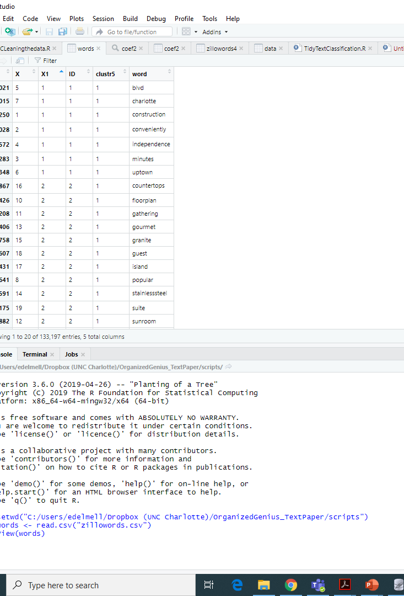
Text processing
Data from Zillow of all properties list for sale in September 2019
N = 8,448 property records
Single Family Homes for Sale
Remove Stop-Words (‘the’, ‘and’, ‘or’…)
Remove words common to all homes (‘bedroom’, ‘bathroom’, house’)
Remove other unhelpful words (phone numbers, names of realtors)
Merge terms that make more sense together
E.g., LightRail, CulDeSac, MultipleOffers
Create generic terms for specific ones (e.g. NeighborhoodName, Restaurant)
Tokenization of text (TidyText)

Slide 12
Predictive analytical framework
Split data into testing vs. training dataset (75/25%)
Train binomial logistic regression with LASSO selection of variables (glmnet)
Prediction of neighborhood type property is located in using text from public remarks (type X vs. all other types)
Two purposes: (1) Predictive power of words in describing neighborhood types and (2) to determine the relative importance of each word in discriminating between types
Brand new construction , house has never been living in . Open floor plan , one level . House is conveniently located , minutes from Independence Blvd and uptown Charlotte .
→ Probability listing associated with neighborhood type

Slide 13
Exploratory text analysis
Notes:
From the figure, we can first observe that the neighborhood name placeholder features prominently in all neighborhood types when simply examining the raw count of words. This is also the case for certain adjectives – “beautiful”, for example is a top word for all neighborhood categories.
However, note the difference in the relative frequency in the neighborhood name and the next most commonly used word (e.g., hardwood in White-Higher Income neighborhoods). For property listings in neighborhoods with a majority or increasing share of white homebuyers, the neighborhood name is used approximately three times as often as the next most common word. On the other hand, in listings in neighborhoods with an increasing share of minority homebuyers, the difference in frequency between neighborhood name and the next most common word is very small. This points to a comparatively higher importance of mentioning specific neighborhood names among neighborhoods attracting white homebuyers as compared to minorities.
Digging deeper into the graphs reveals additional distinguishing characteristics between words according to neighborhood groups. For instance, in the White Homebuyers-Minority Neighborhoods group, words alluding to revitalizing neighborhoods close the urban core are included such as “downtown”, “updated”, “renovated” ranks high. The suburban nature of the Increasingly Black and Hispanic Homebuyers Minority Neighborhoods is also apparent with words such as “garage”, “car”, and “culdesac” whereas “walk” is the only mobility-oriented mention in the predominantly white homebuyer neighborhoods.

Slide 14
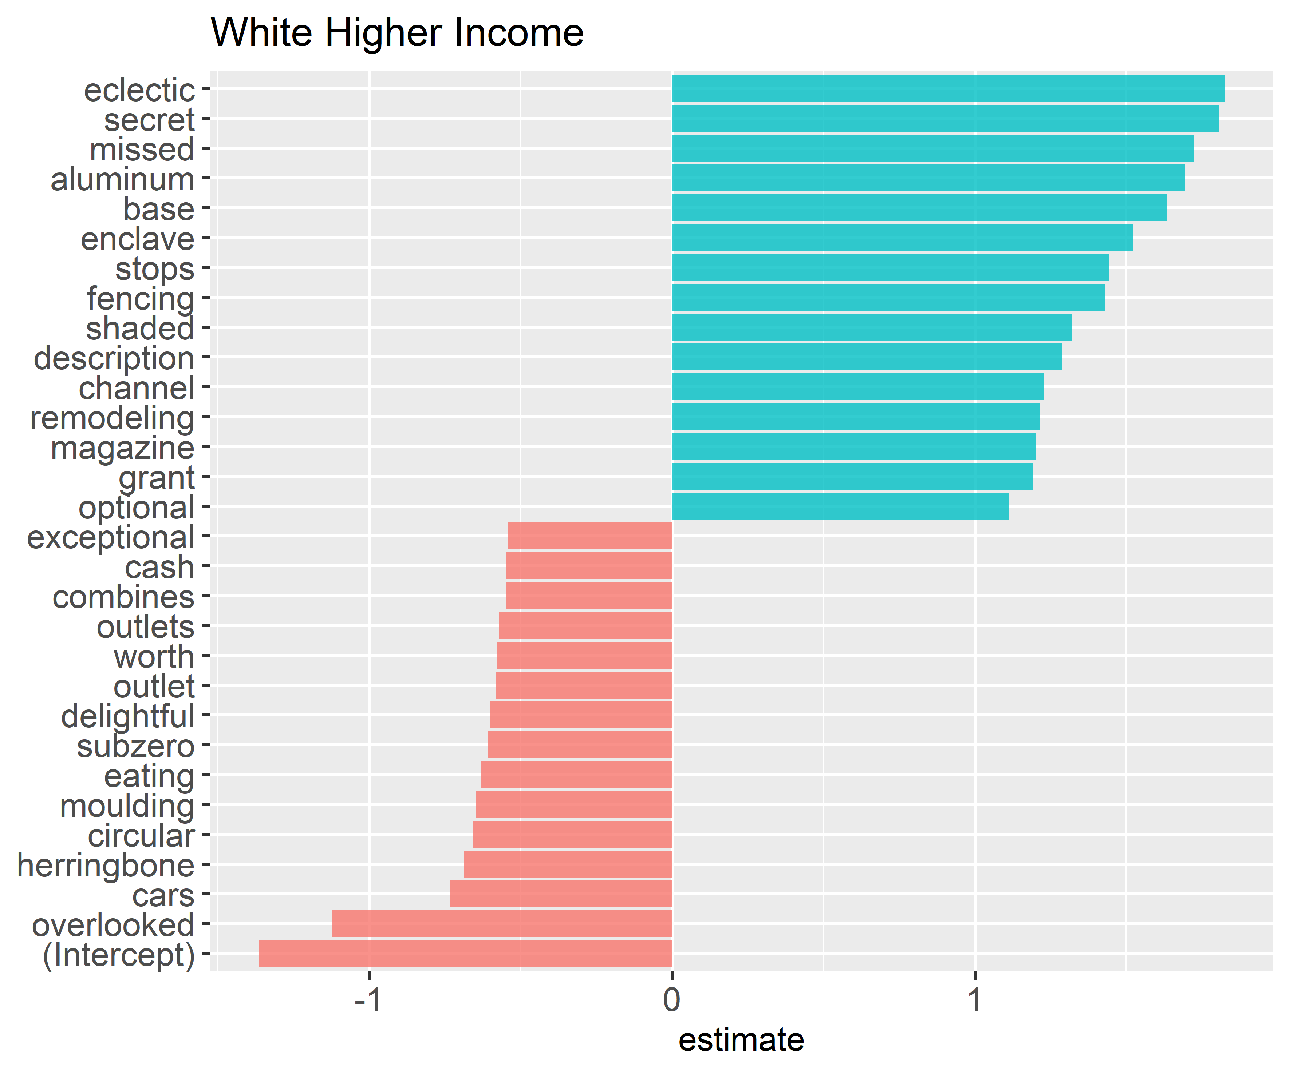
Class 1
Accuracy: 75%
Recall: 21.1%

Slide 15
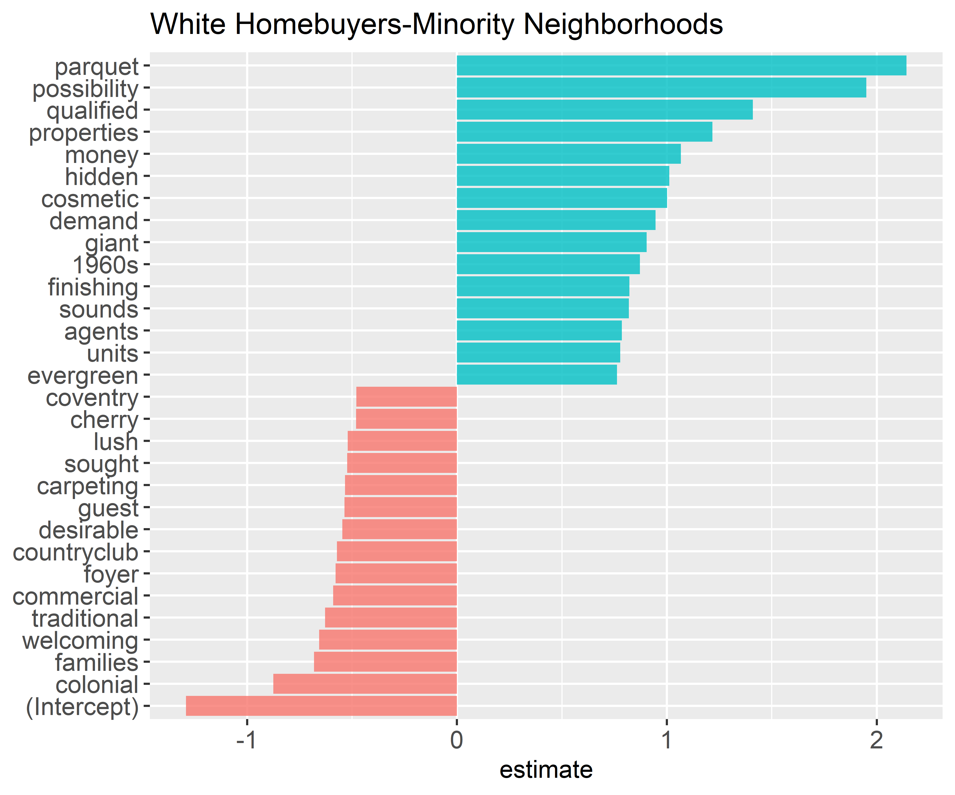
Class 2
Accuracy: 81%
Recall: 17%
Notes:
Turning to the White Homebuyers-Minority Neighborhoods class, we see that “parquet” flooring is a key advertised home feature in these currently gentrifying neighborhoods.
Other words such as “demand” signals a hot home market that a realtor is likely to capitalize on to garner a premium price.
“Possibility” and “cosmetic” indicate that the properties are being advertised to an individual seeking a home to fix-up or possibly flip for a profit in a high demand market.
“Qualified” is a word that may allude to some discriminatory practices as though only certain homebuyers qualify for these homes in historically minority neighborhoods.
Finally, “families” is one of the most negatively associated words with these types of neighborhoods, giving credence to the notion of a city increasingly divided by age – with families in the suburbs and child-less households in the center.

Slide 16
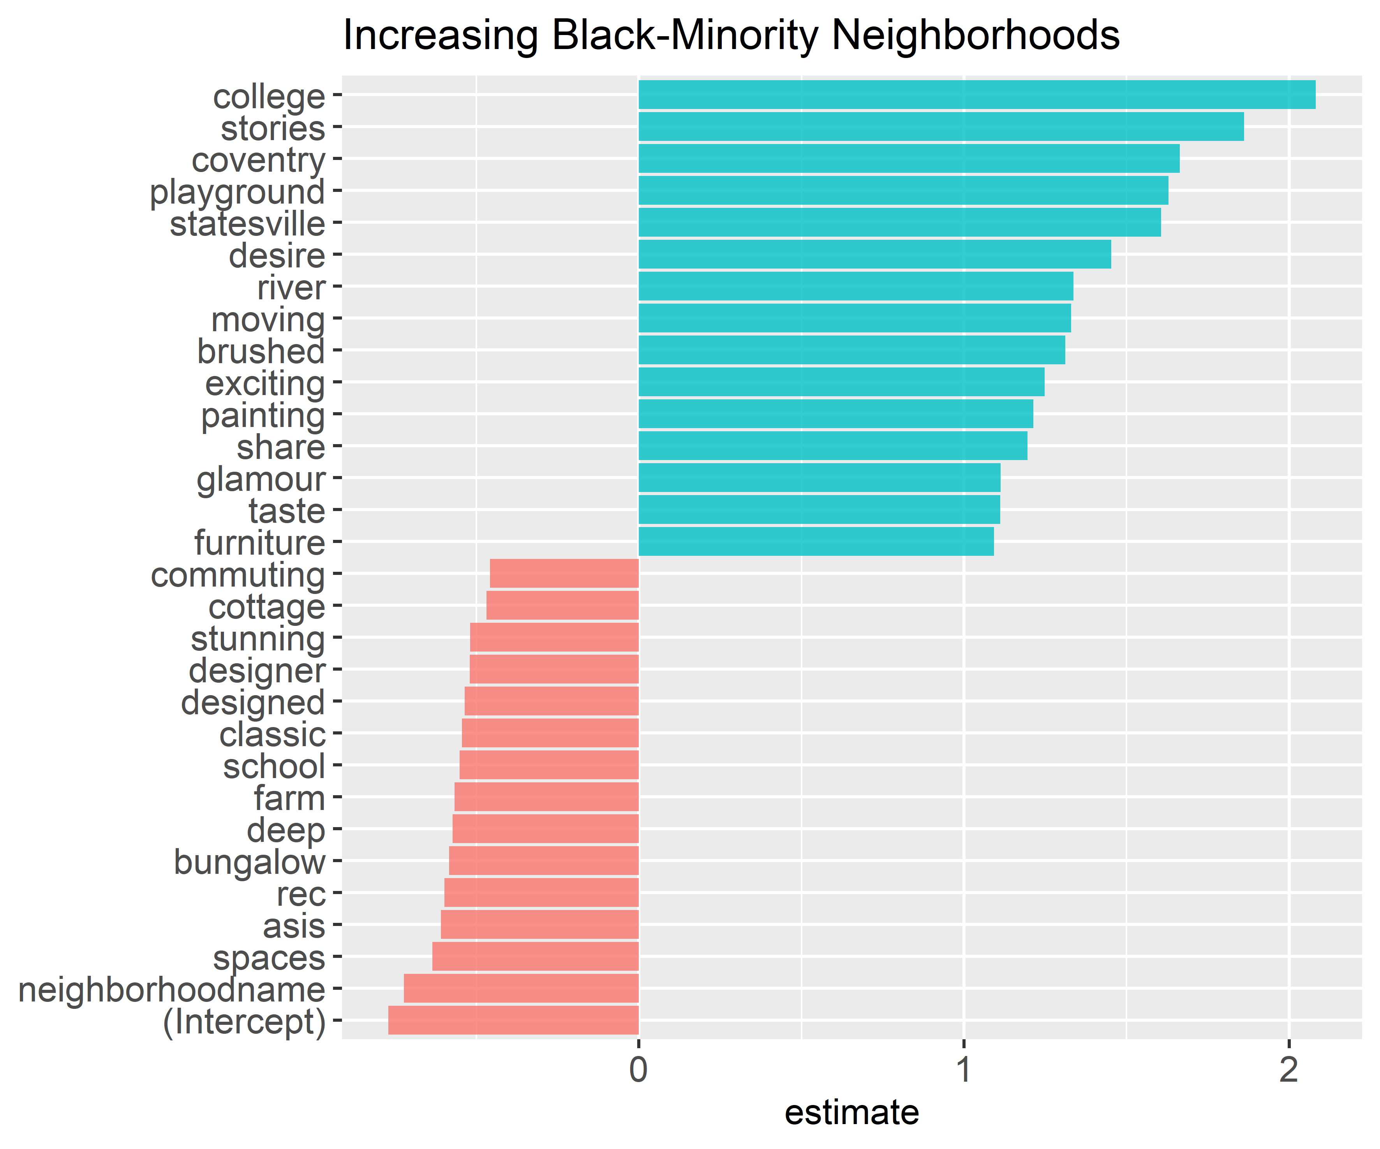
Class 3
Accuracy: 78%
Recall: 10%
Notes:
For the Black Homebuyer -Minority Neighborhood type, we see that the generic neighborhood name placeholder falls to the bottom as the most negatively associated term – this is also true for the Hispanic Homebuyer neighborhoods suggesting that mentioning the specific neighborhood the property is in carries more prestige in neighborhoods where whites are the predominant homebuyer.
We also see the home type for the black homebuyer neighborhood reflects newer subdivision (multi-storied) homes with a lack of historical character (as identified by “stories” and a negative relationship with “bungalow”).

Slide 17
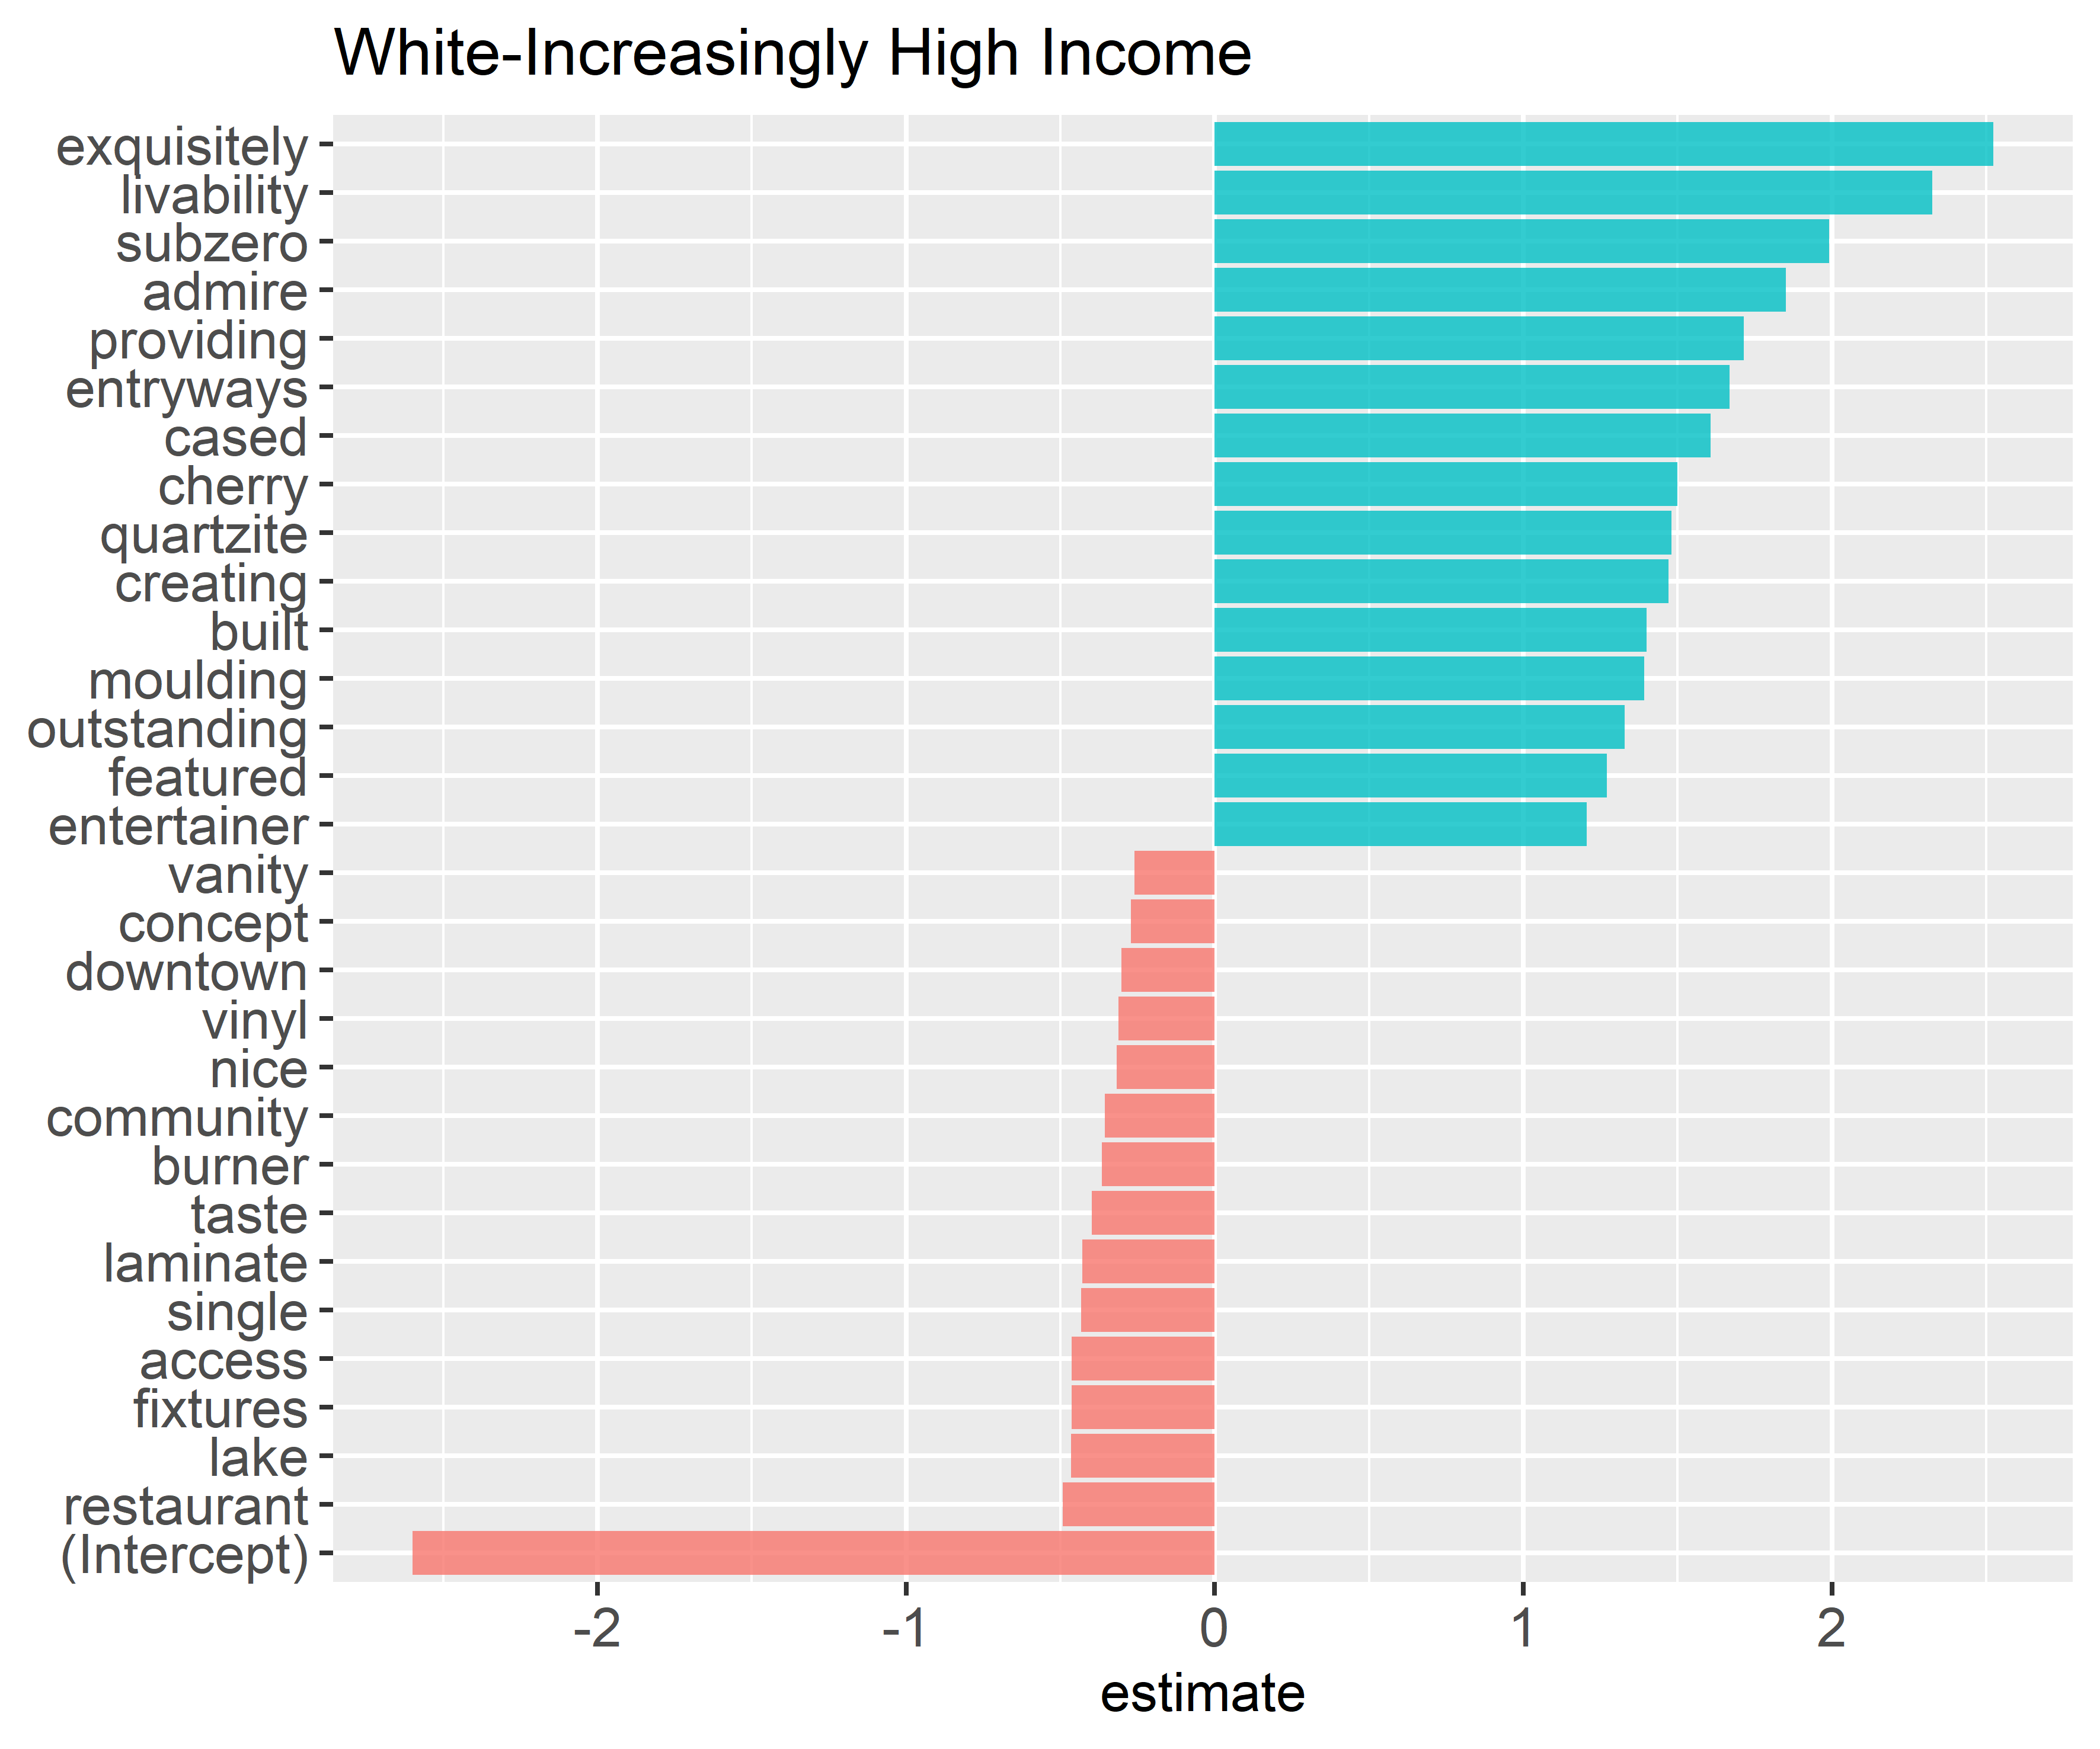
Class 4
Accuracy: 82%
Notes:
White-Increasingly High-Income neighborhoods feature very expensive home attributes (“subzero” appliances, “quartzite”, “cherry”) and attribute choice words of “exquisitely” instead of “nice”.

Slide 18
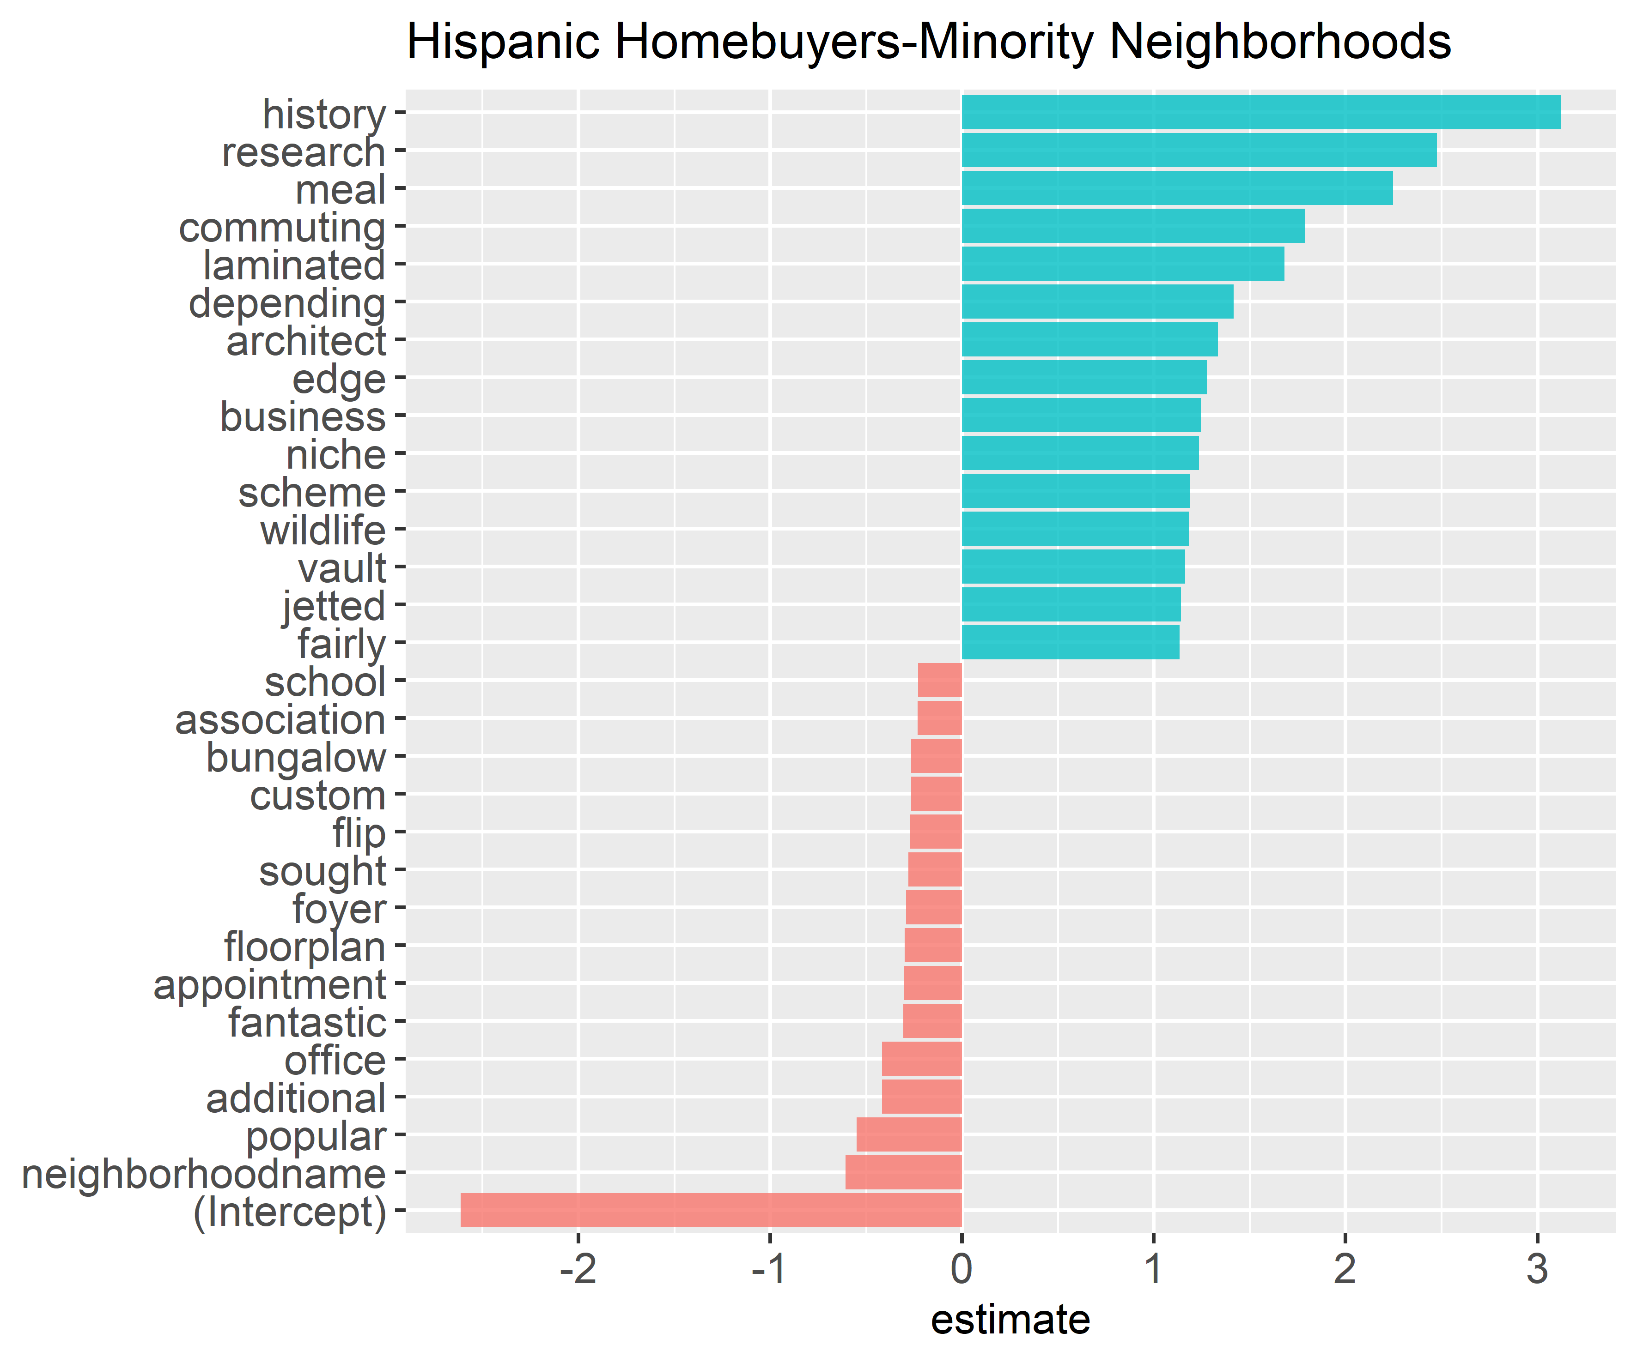
Class 5
Accuracy: 93%
Notes:
Schools are also negatively with black and Hispanic homebuyer neighborhoods. As well as bungalow, custom, flip, popular, and as noted before, the mentioning of the neighborhood name.

Slide 19
Conclusions
Caveat: small, non-longitudinal dataset used as proof-of-concept
From this initial exploratory dataset, we can extract some trends from text descriptions:
Suburban-indicators in neighborhoods with minority homebuyers (“garage”, “car”, “cul-de-sac”)
“Renovated”, “custom”, “walk” and higher end property features in neighborhoods with mainly white homebuyers
Mentioning of neighborhood name and “school” negatively associated with neighborhoods with large shares of minority homebuyers
Mentioning of the neighborhood name relatively more important in ads in white, higher income neighborhoods
Notes:
In this pilot study, we analyzed how the text used to advertise real estate properties varied according to the racial and income profile of homebuyers in different types of neighborhoods. Drawing from amenity-based theories of residential location choice and historical practices of real estate agents serving as neighborhood gatekeepers as they seek to maximize profits to attract particular homebuyers to neighborhoods, we hypothesized that the language of the advertisement would vary by neighborhood. Using a small, 1-month sample property listing dataset as a proof of concept for Charlotte, North Carolina, we developed a framework for analyzing words by neighborhoods and for predicting neighborhood type.
While the accuracy of the binomial models for each neighborhood type is fairly high given the small sample size, it mainly comes from the high share of true negatives. The small sample size makes our sample have a rather unbalanced distribution as well as noisy and sensitive to outliers. We believe that the predictive performance will increase with a larger sample including more properties across multiple cities. Regardless, even with this small sample, the method shows the potential to predict neighborhood types based on words from property advertisement descriptions.

Slide 20
Part 2: The Methods

Slide 21



Just a bit about k-means
Machine Learning
Regression (continuous)
Classification (discrete)
Supervised
Unsupervised
Classify “unlabeled” data into predetermined # of classes

Slide 22
How do they do it?
Cluster Analysis
Collection of techniques used to organize data into meaningful groups (clusters) that are relatively homogeneous with respect to a specified set of attributes.
Maximize association between objects in the same group.
Minimize association between groups.
% voters for Big Bird
Uses concepts of dissimilarity or distance in n dimensional space.
income

Slide 23
Measuring similarity
‘Distance’ between variables
EUCLIDEAN DISTANCE(X,Y) = ( |X₁-Y₁|² + |X₂-Y₂|^{2 + ... +} |X_{N-1}-Y_{N-1}|² ⁺ |X_{N}-Y_{N}|² )^{1/2}
Age = 20
Height = 170
Weight = 80
Age = 30
Height = 160
Weight = 120
EUCLIDEAN DISTANCE(X,Y) = ( |20-30|² + |170-160|^{2 + ... +} |80-120|² )^{1/2}
=42.46

Slide 24
Variables on Different Scales
Should Normalize first (create z-score)
Subtract from mean, divide by standard deviation.
Places all values on scale where 0=mean & each integer is standard deviation above and below the mean.

Slide 25
K-means
Start
Most popular partitioning clustering method
Uses within-cluster variation as a measure to form homogenous clusters.
Segment data in such a way that within-cluster variation is minimized.
Number of Cluster k
Centroids
No object moved?
End.
Distance objects to centroids
Grouping based on min. distance

Slide 26
K-means
Step 1: Determine the number of clusters;
Randomly select center for each cluster
F
A
D
B
E
CC1
C
G
CC2
H

Slide 27
K-means
Step 2: Calculate Euclidean distance from the cluster center to every object. Each
object is then assigned to the cluster center with the shortest distance to it.
F
A
D
B
E
CC1
C
G
CC2
H
Initial Partition

Slide 28
K-means
Step 3: Calculate the centroid of each cluster (mean values of objects contained in
the cluster for each variable)
F
A
D
B
E
CC2’
CC1
C
G
CC2
H

Slide 29
K-means
Step 4: Calculate distance from each object to the new cluster center. Change
assignments if necessary
F
A
D
B
E
CC2’
CC1
C
G
CC2
H

Slide 30
K-means
Repeat steps 3 and 4 until convergence is achieved (there is no change in the cluster affiliations)
Benefits of k-means:
Less sensitive to outliers
Less computationally demanding compared to hierarchical methods.
Use only on interval or ratio-data.

Slide 31
Text As Data: The Lingo
Corpus: large set of text or documents that we are analyzing
Token: unit of text. Usually a word.
Tokenization: Process of splitting text into tokens

Slide 32
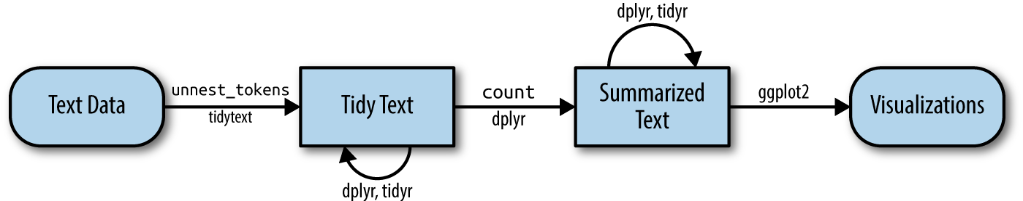
Storing Text in the Computer (From text to Mathematical Objects
String
Corpus
Document-term-Matrix
TidyText format (R Specific)

Slide 33
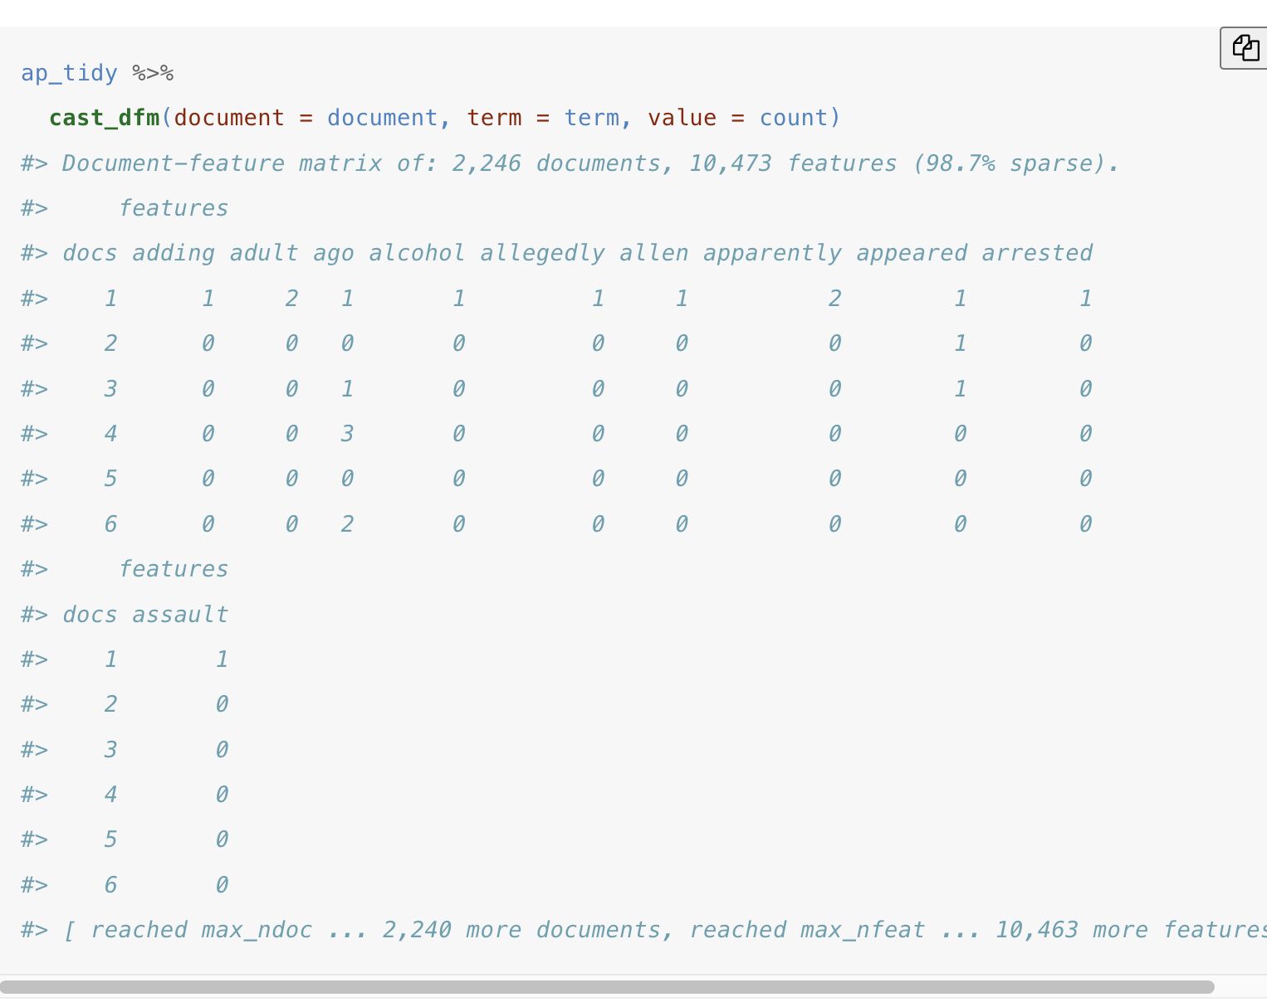
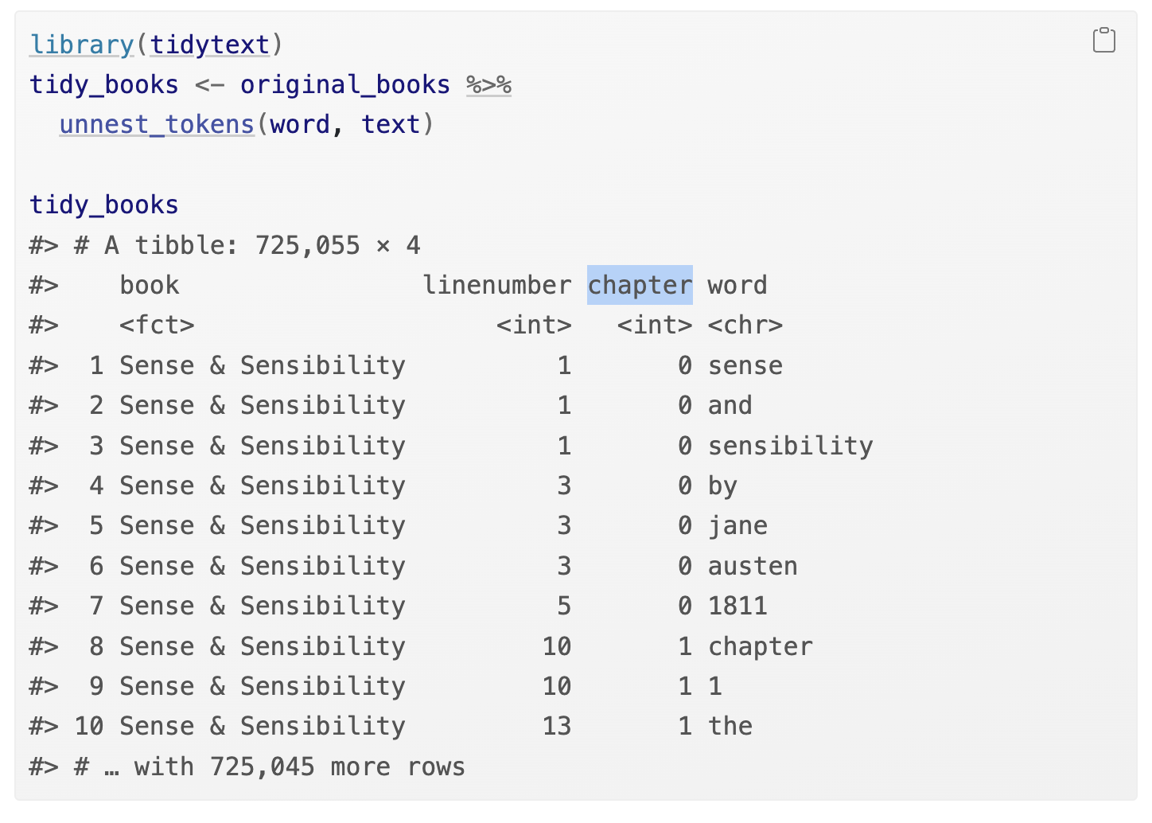
Document-Term Matrix\Tidy Text
“Bag of Words”
https://bookdown.org/Maxine/tidy-text-mining/

Slide 34
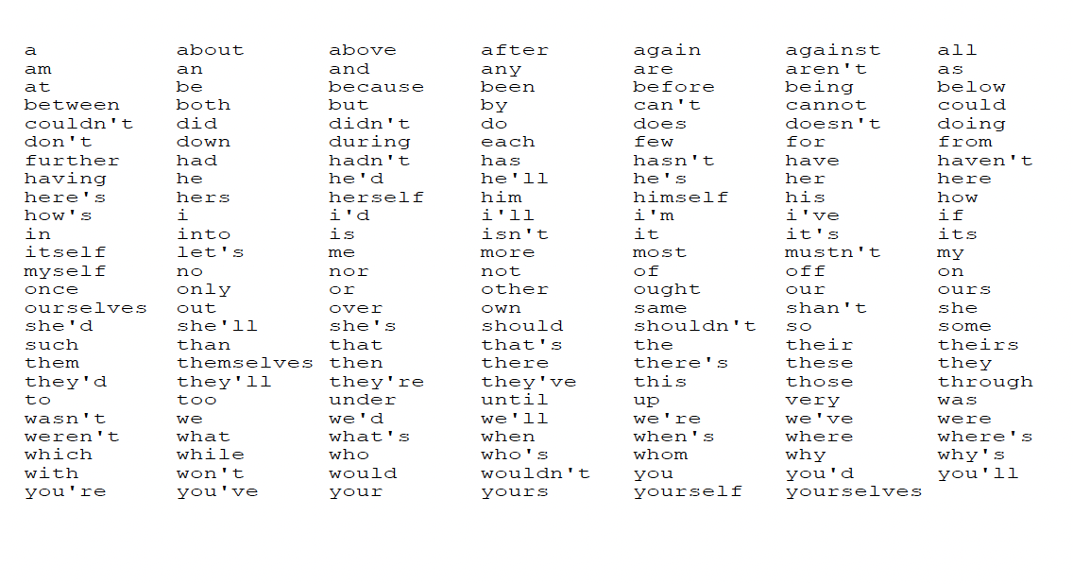
Simplifying Documents
Remove Stopwords
Remove Whitespaces
Stemming (walking, walked, walks → walk
Remove Punctuation, Numbers

Slide 35
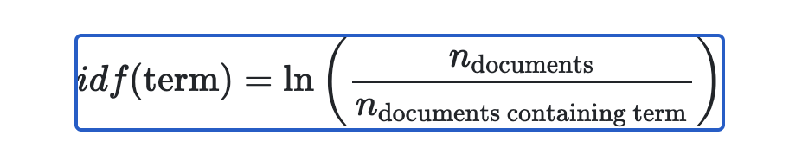
Quantifying Text
Term Frequency (tf): how frequently a term appears in a document.
Inverse Document Frequency (idf): less weight to common words, more for less frequent words.
tf-idf: tf*idf -> frequency of term adjusted for how frequently it is used.
https://www.tidytextmining.com/tfidf.html

Slide 36
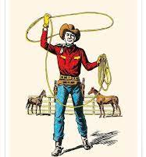
Text Classification (& The LASSO)
Least Absolute Shrinkage and Selection Operator
Feature selection\Regularization Method
Shrinks coefficients of unimportant predictors to 0.

